Slide 1

Presented by Phuc Nguyen
23/04/2025
Data Analysis
Optimizing revenue of a online retail comapany by leveraging insights from sales dataset

Slide 2
Today's Agenda
1
Introduction
2
Data Analysis
3
Outcomes

Slide 3
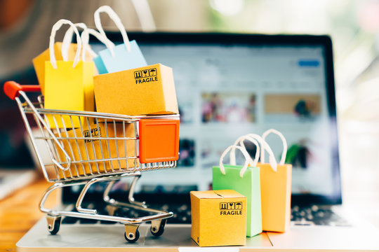
Introduction
Objective:
Optimizing revenue by leveraging insights from top-selling products, customer behaviors and time-based revenue analysis
Tomas
Dataset:
Dataset Name: UK Online Retail Sales and Customer Transaction Data
Source: https://www.kaggle.com/datasets/thedevastator/online-retail-transaction-data
Description: InvoiceNo, StockCode, Description, Quantity, InvoiceDate, UnitPrice, CustomerID, Country

Slide 4
Data Analysis
1
Overall Statistics
2
Top 10 Selling Products
3
Purchase behavior
4
Time-based analysis

Slide 5
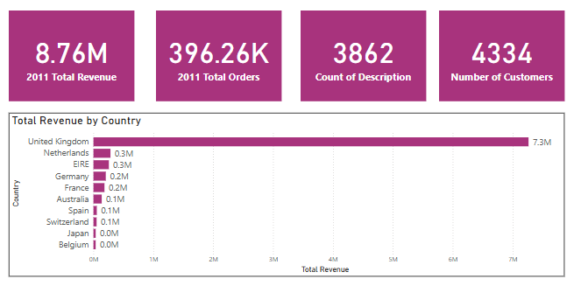
1
Overall Statistics
Total Revenue: 8.76M → strong performer among small to mid-sized e-commerce
4,300 customers and 400,000 orders → significant operational scale for a non-store online
3,800 distinct product codes → diverse product catalog for a non-store online retailer

Slide 6
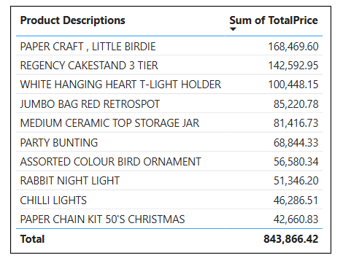
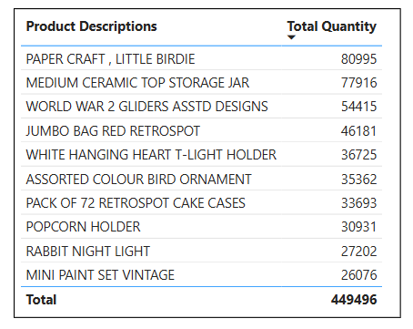
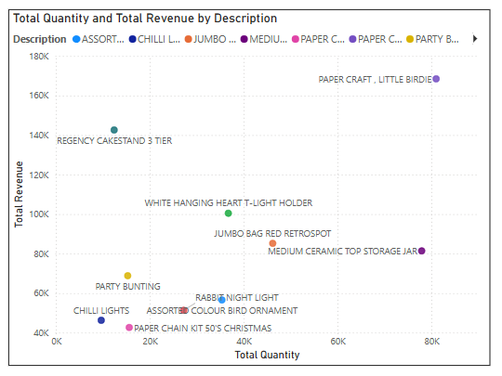
2
Top 10 Selling Products
Dominates both revenue and volume:
PAPER CRAFT , LITTLE BIRDIE (£2.08)
Hero product
High revenue but aren’t high in quantity
REGENCY CAKESTAND 3 TIER (£12.75)
No.2 in Total Sales (£142,592.95)
Not in Top 10 by Quantity
Top in both lists
WHITE HANGING HEART T-LIGHT HOLDER (£2.55)
JUMBO BAG RED RETROSPOT (£1.95)
MEDIUM CERAMIC TOP STORAGE JAR (£1.25)
fast-moving, well-priced, and widely liked.

Slide 7
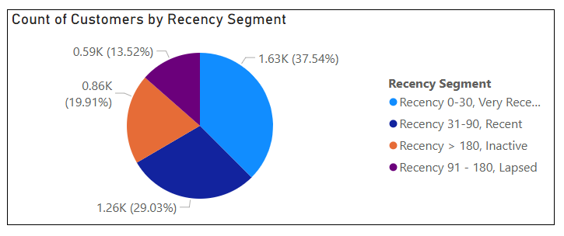
3
Purchase behavior
Segment customers based on Recency, which measures the number of days since each customer’s most recent purchase.
Reference date for calculating recency: one day after the last date in your dataset.

Slide 8
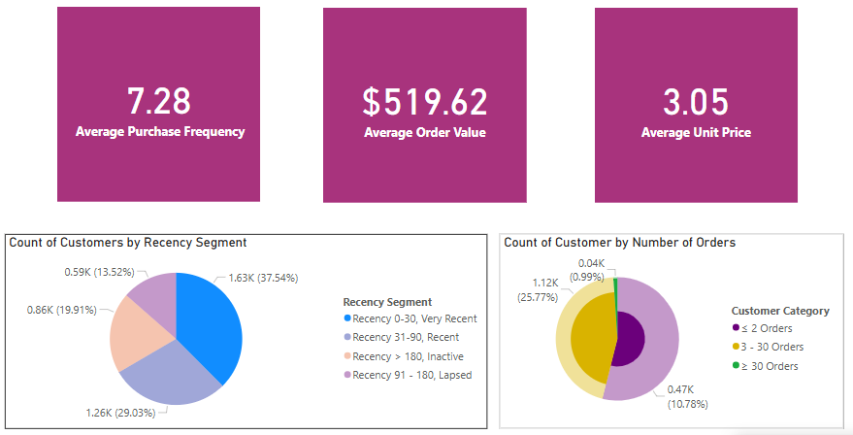
3.1 Very Recent Segment (Recency from 0-30 days)
Insights:
High Engagement Group
largest group, making up 37.54% of total customers
Likely contains both retail and wholesale
Likely contributes strongly to revenue
Recent purchasers and AOV is high ($519.62) → large share of recent revenue
Overlap with high-frequency buyers
Many ≥ 30 Orders group (25.77%) → key loyalty drivers
Recommendations:
For those with ≥30 orders → Invite to join loyalty program
For one-time buyers → Offer next-purchase discounts, recommend relevant products

Slide 9
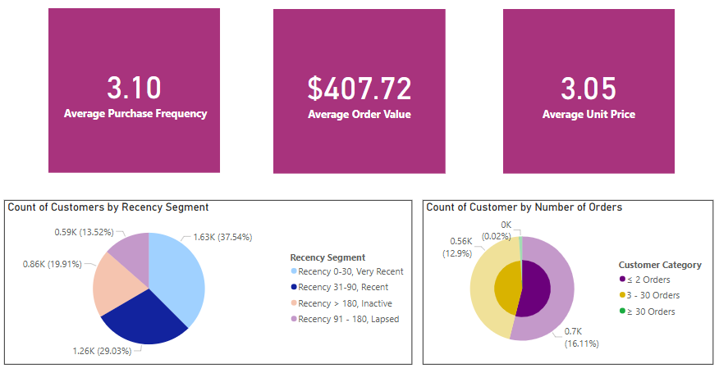
3.2 Recent Segment (Recency from 31-90 days)
Insights:
Moderately Engaged Group
Purchase frequency = 3.10 → bought more than once, but not frequently.
Includes both repeat retail customers and small wholesale buyers.
Solid AOV but Lower than Very Recent
AOV = $407.72 vs. $519.62 (Very Recent)
Important for mid-level revenue → nudged to re-engage before they lapse
At-risk of churn
The sweet spot for reactivation
Nnot cold yet, but may soon Lapsed or Inactive
Recommendations:
Re-engagement emails with discounts (10%) and new product updates
Loyalty incentives and automated follow-ups at 45/60/75 days

Slide 10
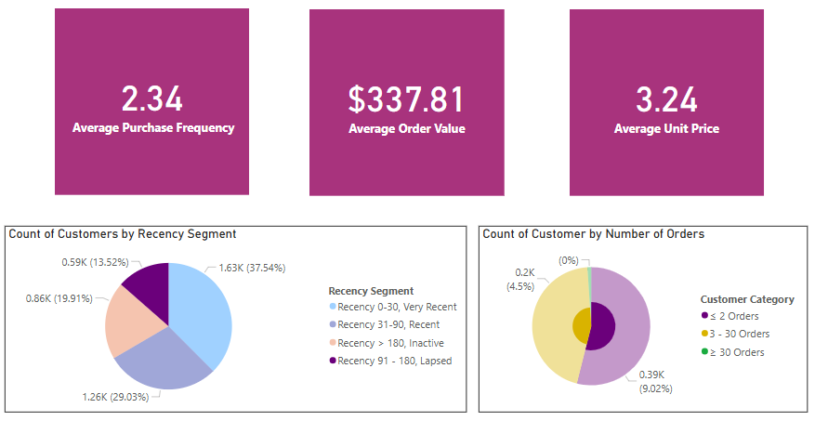
3.3 Lapsed Segment (Recency from 91-180 days)
Insights:
Moderately disengaged group
PF = 2.34: most of these customers purchased more than once, but not often
Many haven’t purchased in 3–6 months → at risk of being lost
Declining order value
AOV is $337.81, lower than Recent ($407.72) and Very Recent ($519.62)
Indicates potential drop in interest, loyalty, or relevance of current products
Smaller proportion of loyal buyers
Only 4.5% have made ≥30 orders
Meanwhile, 9% are near one-time buyers (≤2 orders)
Recommendations:
Win-back campaigns with bold offers (e.g. 20% off)
Remind past interests and create urgency
Use bundles or tiered discounts to boost return
Identify drop-off reasons via quick surveys

Slide 11
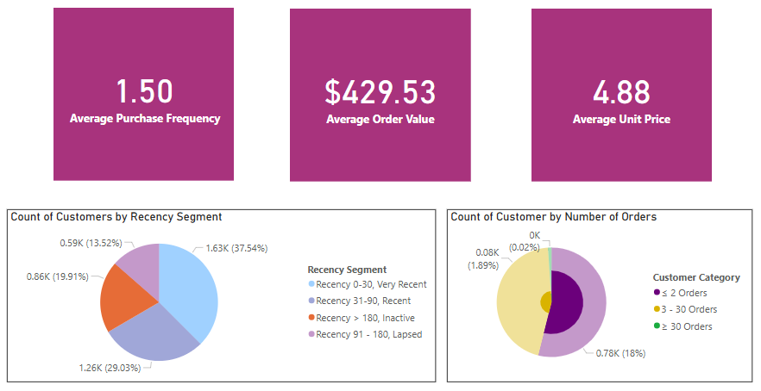
3.4 Inactive Segment (Recency >180 days)
Insights:
Lowest engagement across all segments
PF = 1.50 → majority are one-time or at most two-time buyers
Likely churn or being permanently lost
Surprisingly high AOV
Despite being inactive, AOV = $429.53, which is higher than:
Lapsed ($337.81)
Recent ($407.72)
Suggests these may be one-time wholesale or gift buyers with large orders
High unit price = high-value products
AUP = $4.88, the highest among all segments → purchases may have been fewer items, but more expensive ones
Recommendations:
Target high-AOV one-timers with personalized reminders
Use strong reactivation offers like flash sales or deep discounts
Reduce contact frequency if unresponsive to save costs
Collect feedback through quick win-back surveys

Slide 12
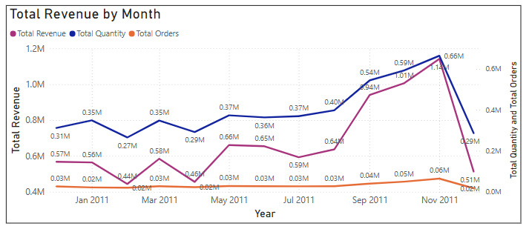
4
Time-based analysis
4.1 Monthly Revenue
Insights:
Climbs steadily, November is the peak month
Quantity increased steadily in line with revenue, while the number of orders remained relatively stable →
January to July, majority: retails
August to November, wholesales buyers dominant
Recommendations:
Target wholesalers early with July bulk-buy campaigns
Prep inventory for Aug–Nov peak demand
Shift messaging seasonally: personal gifts (H1) → bulk/holiday (H2)

Slide 13
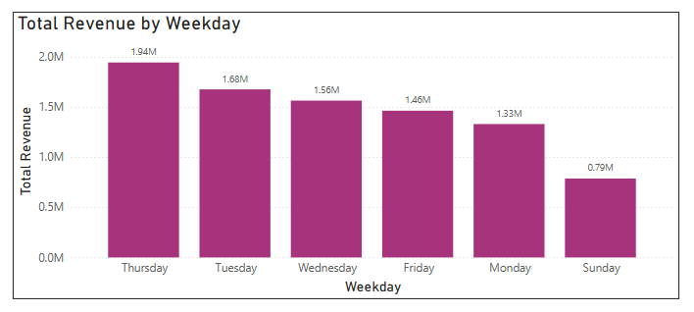
4.3 Revenue by Weekday
Insight:
Tuesday and Thursday are top-performing days; Sunday is the weakest.
Recommendations:
Launch new products or promotions on Tuesdays/Thursdays for maximum impact.
Schedule ads/posts during these high-performing days using data-driven automation.
Use Sunday for storytelling content (blog posts, behind-the-scenes) or light engagement → test content-driven brand touchpoints.

Slide 14
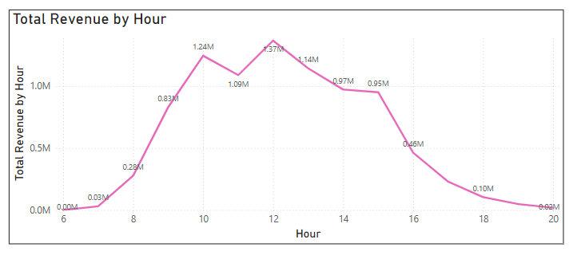
4.3 Revenue by Hour
Insight:
Most purchases happen between 9AM–2PM (UK time).
Recommendations:
Schedule email blasts and promotions to hit inboxes between 8–9AM.
Ad scheduling: Focus Facebook/Google ads budget between 9AM–2PM.
Live chat/Customer support availability should prioritize this window.

Slide 15
Outcomes:
Product Strategy
Promote PAPER CRAFT, LITTLE BIRDIE with bundles, bulk deals, and ad focus
Highlight REGENCY CAKESTAND 3 TIER in premium, gift-oriented campaigns
Cross-sell consistent sellers in seasonal bundles
Ensure stock, track monthly bestsellers, and optimize packaging to drive repeat purchases
Customer Segmentation (Recency-based)
Very Recent (0–30): High-value, loyal → focus on upsell & retention
Recent (31–90): Still active → re-engage with offers
Lapsed (91–180): Fading → win-back with reminders/discounts
Inactive (>180): Mostly one-timers → target high-AOV only, reduce outreach to others
Time-Based Revenue Insights
Sales peak in Nov → prep campaigns & stock for Q4
Best days: Tues & Thurs → schedule key launches and ads
Top hours: 9AM–2PM → push emails/ads in this window

Slide 16
Thank you!
Q&A Session

